Slide 1
Data Warehousing - session -1
Mr. Atul Vaze
Certified BI Specialist(OBIEE)
Certified Agile Coach (ICP-ACC)
Function Point Specialist
Six Sigma GB

Slide 2
Class Introduction
      Name :
      Work Domain : < e,g Retail , Finance, Manufacturing ..etc>
      Project Type : < e,g Development, Support & Maintainance , UI ..etc>
      Your Role in Project :
      Exposure to DW & BI :

Slide 3
TOPICS
What is Process, Project and Program
Software Engineering
Challenges faced by Project Manger
Process Vs Project Vs Program
Role of Project Manager
Project Stakeholders
Software Process Flow
Software Evolution
Software Development Life Cycle (SDLC)
Choice of SDLC model

Slide 4
Books
Text Books:
T1: Ponniah P, “Data Warehousing Fundamentals”, Wiley Student Edition, 2012
T2: Kimball R, “The Data Warehouse Toolkit”, 3e, John Wiley, 2013
Reference Books :
R1 : Anahory S, & Dennis M, “Data Warehousing in the Real World”, Pearson Education, 2008.
R2 : Kimball R, Reeves L, Ross M, & Thornthwaite, W, “The Data Warehouse Lifecycle Toolkit”, John Wiley, 2e, 2012.
R3: Jiawei Han, Micheline Kamber and Jian Pei, “Data Mining: Concepts and Techniques”, Morgan Kaufmann Publishers 2012
R4: Krish Krishnan, “Data Warehousing in the Age of Big Data”, Morgan Kaufmann Publishers 2013
Note: In order to broaden understanding of concepts as applied to Indian IT industry, students are advised to refer books of their choice and case-studies in their own organizations

Slide 5
From DBMS to Decision Support
DBMSs widely used to maintain transactional data
Attempts to use of these data for analysis, exploration, identification of trends etc. has led to Decision Support Systems.
Rapid Growth since mid 70’s
DBMSs vendors have answered this trend by adding new features to existing products
Rarely enough

Slide 6

What are the users saying...
Data should be integrated across the enterprise
Summary data has a real value to the organization
Historical data holds the key to understanding data over time
What-if capabilities are required

Slide 7
Evolution
60’s: Batch reports
  hard to find and analyze information
  inflexible and expensive, reprogram every new request
70’s: Terminal-based DSS and EIS (executive information systems)
  still inflexible, not integrated with desktop tools
80’s: Desktop data access and analysis tools
  query tools, spreadsheets, GUIs
  easier to use, but only access operational databases
90’s: Data warehousing with integrated OLAP engines and tools

Slide 8
Very Large Data Bases
Terabytes -- 10^12 bytes:
Petabytes -- 10^15 bytes:
Exabytes -- 10^18 bytes:
Zettabytes -- 10^21 bytes:
Zottabytes -- 10^24 bytes:
Walmart -- 24 Terabytes
Geographic Information Systems
National Medical Records
Weather images
Intelligence Agency Videos

Slide 9
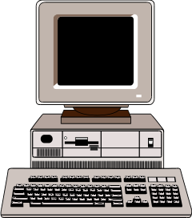

Data Warehouse Architecture
Relational
Databases
Extraction
Cleansing
Optimized Loader
ERP
Systems
Data Warehouse
Engine
Analyze
Query
Purchased
Data
Legacy
Data
Metadata Repository

Slide 10
OLTP Systems
Has relational normalized design
Redundant data is undesirable
Consists of many tables
High volume retrieval is inefficient
Optimized for repetitive “narrow” queries
Common data in many applications

Slide 11
Need for Data Warehousing
Companies, over the years, gathered huge volumes of data
“Hidden Treasure”
Can this data be used in any way?
Can we analyze this data to get any competitive advantage?
If yes, what kind of advantage?

Slide 12
Benefits of Data Warehousing
Allows “efficient” analysis of data
Competitive Advantage
Analysis aids strategic decision making
Increased productivity of decision makers
Potential high ROI
Classic example: Diaper and Beer
More recently: Polo shirts & Barbie dolls

Slide 13
Decision Support Systems,
DW, & OLAP
Information technology to help the knowledge worker (executive, manager, analyst) make faster and better decisions.
Data Warehouse is a DSS
A data warehouse is an architectural construct of an information system that provides users with current and historical decision support information that is hard to access or present in traditional operational systems.
Data Warehouse is not an Intelligent system
On-Line Analytical Processing (OLAP) is an element of DSS

Slide 14


What is Data Warehouse ?
Bill Inmon, an early and influential practitioner, has formally defined a data warehouse
in the following terms;
(Top Down Approach)
A data warehouse is a subject-oriented, integrated, time-variant and non-volatile
collection of data in support of management's decision making process;
Subject-oriented : The data in the database is organized so that all the data elements relating to the same real-world event or object are linked together;
Integrated : A data warehouse integrates data from multiple data sources. For example, source A and source B may have different ways of identifying a product, but in a data warehouse, there will be only a single way of identifying a product.
Time-variant :Historical data is kept in a data warehouse. For example, one can retrieve data from 3 months, 6 months, 12 months, or even older data from a data warehouse. This contrasts with a transactions system, where often only the most recent data is kept. For example, a transaction system may hold the most recent address of a customer, where a data warehouse can hold all addresses associated
Non-volatile : Data in the database is never over-written or deleted - once committed, the data is static, read-only, but retained for future reporting;
Ralph Kimball, a leading proponent of the dimensional approach to
building data warehouses, provides a succinct definition for a data
warehouse: He defines data warehouse as “A copy of transaction data
specifically structured for query and analysis”.
(Bottom Up Approach)
Notes:
Fundamentally, a data warehouse helps to solve the on-going problem of pulling data out of transactional systems quickly and efficiently and converting that data into actionable information. Additionally, the data warehouse allows for processing of large and complex queries in a highly-efficient manner. Upon successful implementation of a data warehouse or data mart, business will realize numerous improvements and positive gains.

Slide 15
Fundamentally, a data warehouse helps to solve the on-going problem of pulling data out of transactional systems quickly and efficiently and converting that data into actionable information.
Additionally, the data warehouse allows for processing of large and complex queries in a highly-efficient manner.
Upon successful implementation of a data warehouse or data mart, business will realize numerous improvements and positive gains.

Slide 16
Why Companies Deploy DW ? (1/3)
Lots of motivators behind why companies deploy a DW
Operational systems are being impacted because of reporting requests
Operational systems cannot give a needed historical perspective
Too expensive / Too difficult to tie source systems together for one-off reporting
No one knows the rules from legacy reporting systems
Investment in a BI tool won’t work without consolidated, rationalized data.
Enables business executives to improve corporate strategies and operational decision making by querying the data warehouse

Slide 17
Why Companies Deploy DW? (2/3)
Lots of promises:
Identify customer needs/ opportunities faster
Understand the effects of market/ product/ service mix on customer behavior
Reduce time to answer business questions
Understand how department decisions impact the company
Lowered cost of analytics
Less time reconciling data
Integrated data is more useful than data in isolation.
Insights
Business
Agility
Support
Growth
Contain
Costs
Focused
Business
Notes:
Even simple decisions – Buy / Not Buy / Discount often need lots of Inputs
Sales Information
Transactional Context
Inventory / Vendor Information
Forecasting / Market Data / Trending
Customer Information
Promotional Information
Now Repeat across every product you carry…

Slide 18
Even simple decisions – Buy / Not Buy / Discount often need lots of Inputs
  Sales Information
  Transactional Context
  Inventory / Vendor Information
  Forecasting / Market Data / Trending
  Customer Information
  Promotional Information

Slide 19
Typical DW Architecture
Data Sources
ETL
Data Store
Data Access
Presentation
Dashboards
System A
The Data
Warehouse
Prompted Views
System B
Scorecards
System C
Extract
Transform
Load
Business Model
System D
Ad-Hoc Reporting
Self Serve

Slide 20
Inside a typical DW
Staging - Operational Data Store
Star / Snowflakes De-Normalized Data
NormalizedData (3NF)
Aggregates For Reporting
ETL
ETL
ETL
Tables which mirror original source systems
Data model in 3rd Normal Form.
The Single Version of the Truth
Data by subject area de-normalized for faster reporting and analysis.
Lots of data duplication
Extracts to improve reporting performance
Implementations may put in either one or both of these layers.

Slide 21
DW Benefits
Some of the key benefits of a DW :
Integrating data from multiple sources
Reducing cost to access historical data
Standardizing data across the organization, a "single version of the truth";
Improving turnaround time for analysis and reporting
Sharing data and allowing others to easily access data
Supporting ad hoc reporting and inquiry
Removing informational processing load from transaction-oriented databases
Increase system and query performance
High returns on investment (ROI)

Slide 22
Data Warehouses and Data Marts
A data mart is a special purpose subset of enterprise data used by a particular department, function or application.
Data marts may have both summary and detail data, usually the data has been pre-aggregated or transformed to better handle the particular type of requests of a specific user community.
Independent Data Marts
Logical Data Marts
Dependent Data Marts
DM1
DM1
DM1
DW
DM2
DM2
DM2
DM3
DM3
DM3
Source Systems
Source Systems
Source Systems
Data Marts
Data Marts
Data Marts

Slide 23
OLTP Systems:
Primary Purpose
Run the operations of the business
For example: Banks, Railway reservation etc.
Based on ER Data Modeling
Transaction based system
Data is always current valued
Little history is available
Data is highly volatile
Has “Intelligent keys”

Slide 24
OLTP Systems
Has relational normalized design
Redundant data is undesirable
Consists of many tables
High volume retrieval is inefficient
Optimized for repetitive “narrow” queries
Common data in many applications

Slide 25
Need for
Data Warehousing
Companies, over the years, gathered huge volumes of data
“Hidden Treasure”
Can this data be used in any way?
Can we analyze this data to get any competitive advantage?
If yes, what kind of advantage?

Slide 26
Benefits of
Data Warehousing
Allows “efficient” analysis of data
Competitive Advantage
Analysis aids strategic decision making
Increased productivity of decision makers
Potential high ROI
Classic example: Diaper and Beer
More recently: Polo shirts & Barbie dolls

Slide 27
Decision Support Systems,
DW, & OLAP
Information technology to help the knowledge worker (executive, manager, analyst) make faster and better decisions.
Data Warehouse is a DSS
A data warewhouse is an architectural construct of an information system that provides users with current and historical decision support information that is hard to access or present in traditional operational systems.
Data Warehouse is not an Intelligent system
On-Line Analytical Processing (OLAP) is an element of DSS

Slide 28
Why Separate Data Warehouse?
Performance
  Op dbs designed & tuned for known txs & workloads.
  Complex OLAP queries would degrade performance for op txs.
  Special data organization, access & implementation methods needed for multidimensional views & queries.
  Current and historical decision support information that is hard to access or present in traditional operational systems.

Slide 29
Why Separate Data Warehouse?
Function
  Missing data: Decision support requires historical data, which op dbs do not typically maintain.
  Data consolidation: Decision support requires consolidation (aggregation, summarization) of data from many heterogeneous sources: op dbs, external sources.
  Data quality: Different sources typically use inconsistent data representations, codes, and formats which have to be reconciled.

Slide 30
Data Warehouse: Characteristics
Analysis driven
Ad-hoc queries
Complex queries
Used by top managers
Based on Dimensional Modeling
Denormalized structures

Slide 31
Data Warehouse
A decision support database that is maintained separately from the organization’s operational databases.
A data warehouse is a
  subject-oriented,
  integrated,
  time-varying,
  non-volatile
collection of data that is used primarily in organizational decision making

Slide 32
Subject Oriented
Data Warehouse is designed around
“subjects” rather than processes
A company may have
  Retail Sales System
  Outlet Sales System
  Catalog Sales System
Problems Galore!!!
DW will have a Sales Subject Area

Slide 33
Subject Oriented
OLTP Systems
Data Warehouse
Subject-Oriented Sales Information
Outlet Sales
System
Catalog Sales
System
Retail Sales System
Sales Subject Area

Slide 34
Integrated
Heterogeneous Source Systems
Little or no control
Need to Integrate source data
For Example: Product codes could be different in different systems
Arrive at common code in DW
“Surrogate keys”

Slide 35
Non-Volatile(Read-Mostly)
Write
USER
Read
Read
USER
OLTP
DW

Slide 36

Time Variant
Most business analysis has a time component
Trend Analysis (historical data is required)
Sales
2001 2002 2003 2004

Slide 37
Data Warehousing Architecture
Monitoring & Administration
OLAP servers
Metadata Repository
Analysis
Query/ Reporting
Data Mining
Data
Warehouse
External Sources
Extract
Transform
Load
Refresh
Serve
Operational dbs
Data Marts

Slide 38
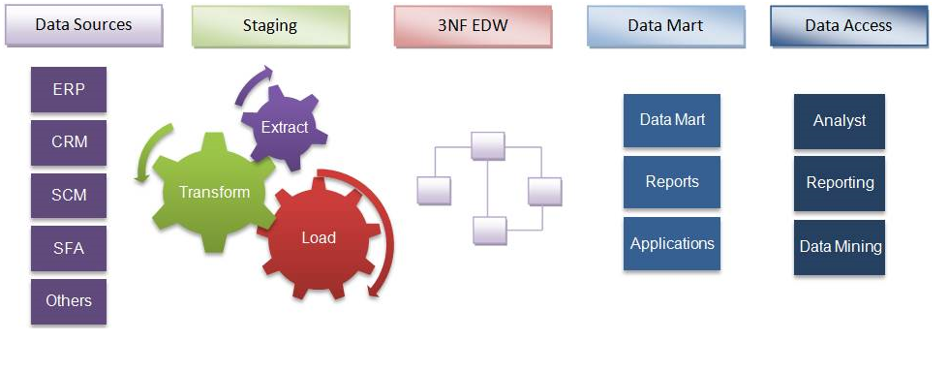
Inmon’s top-down approach
Inmon defines data warehouse as a centralized repository for the entire enterprise. Data warehouse stores the ‘atomic’ data at the lowest level of detail. Dimensional data marts are created only after the complete data warehouse has been created.

Slide 39
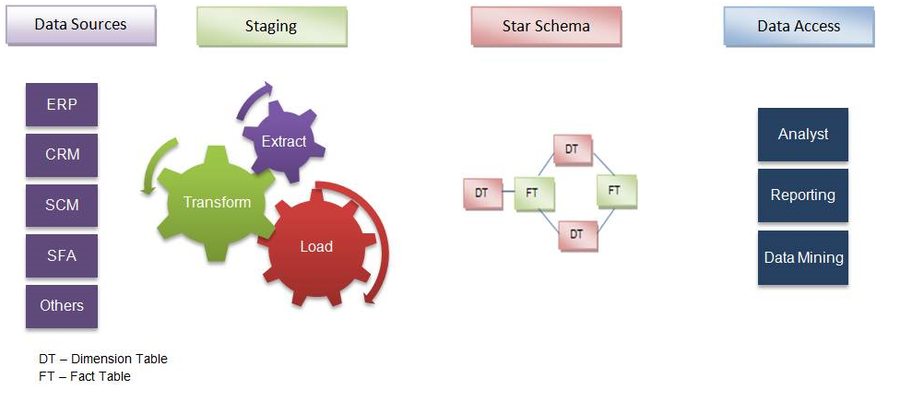
Kimball’s bottom-up approach
Keeping in mind the most important business aspects are departments, data marts are created first. These provide a thin view into the organizational data, and as and when required these can be combined into a larger data warehouse.
Kimball’s data warehousing architecture is also known as Data Warehouse Bus (BUS). Dimensional modeling focuses on ease of end user accessibility and provides a high level of performance to the data warehouse.

Slide 40
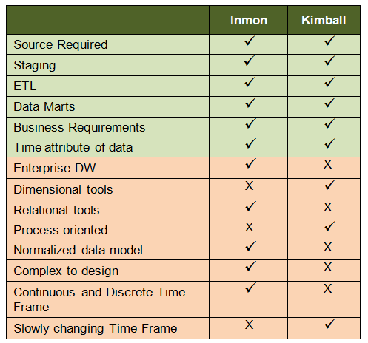
Inmon Vs Kimball: Similar or different?
"You can catch all the minnows in the ocean and stack them together and they still do not make a whale." ~Inmon
“The data warehouse is nothing more than the union of all the data marts" ~Kimball

Slide 41

SS ZG622 Software Project Management – KG Krishna

Slide 42
Thank You
Any Questions?

